Slide 1

Coming Soon
Notes:
(CLICK When sound confirmed)

Slide 2


Slide 3


Slide 4
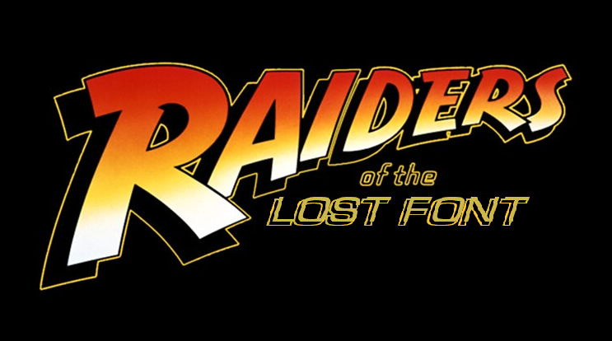

Slide 6


Slide 7

Notes:
Oh. Hello there.
I apologize. Dr. Jones could not be here today. He found himself in a rather… tricky… situation.
Every great adventure starts with research. Dr. Jones and I may chase relics, but we always begin in the archives.
Yes, that’s me. Fedora and all. I figured if I’m going to chase fonts like Indy chases idols, I might as well dress the part.
(click)

Slide 8

Digital Workplace Services - Kyndryl
Texas, USA
First-time presenter
1 dog, 1 cat, 1wife
Hobbies include:
Home automation
Playing the slots
3D Printing
Power Platform
Bob Lamaster
Notes:
My name is Bob Lamaster. Indy usually does these talks, so this is my first time presenting, Please be gentle.
I’m based in Texas, and work for Kyndryl.
I’ve got one dog, one cat, and one wife… which, as I’ve been told, is the correct number of each.
When I’m not here in the archives, or in the field, I enjoy home automation, slot machines, 3D printing, and of course, the Power Platform.
So now, let’s get on to our story. (click)

Slide 9
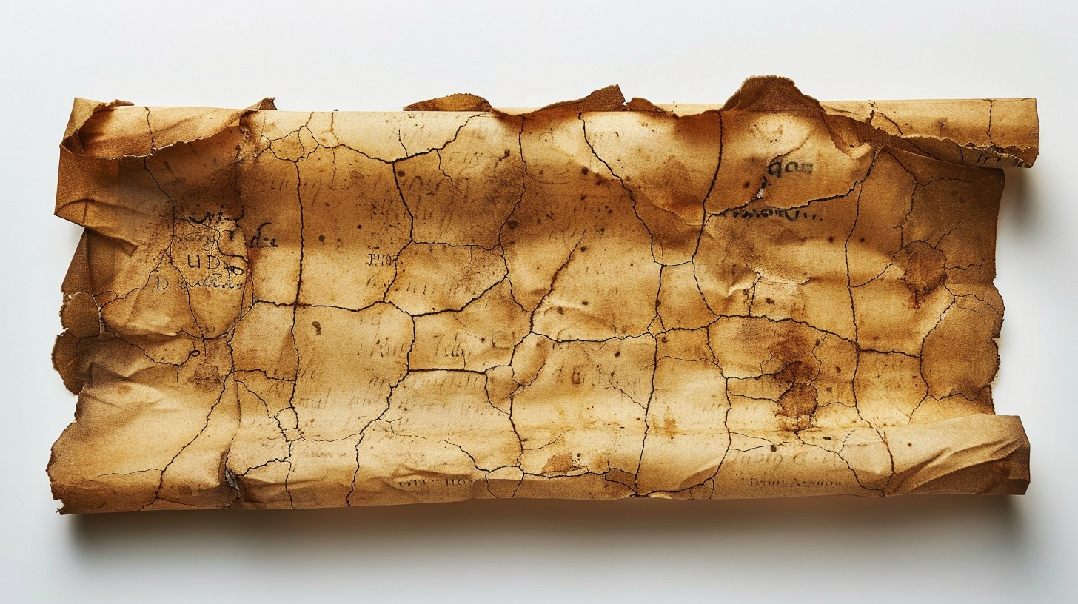
Act I: The Ancient Mysteries
Discovering early custom font techniques in Power Apps
Notes:
Our story starts off, like most stories do, with a quest.
That quest, is to break out of the limitations of the 14 fonts included within Power Apps.
Here in Act I, We’ll explore our earliest attempt to overcome this horrible situation. Dr. Jones and I had a few leads on the location of some ancient wisdom, so, off we set on our grand adventure. (click)

Slide 10


Slide 11

Notes:
The skies were turbulent, but we made it to our first destination. Our lead brought us to the Temple of Locality. It was a curious place, filled with stone book cases, the air thick with a millennia of dust. Eventually, we came upon a pedestal with a small scroll atop it. As we unrolled the scroll, we were astonished to find it quite legible.
It described an ancient practice of using locally-installed fonts in PowerApps. (click)

Slide 12

Solving the ancient mystery:
LOCALLY-INSTALLED FONTS
Creative Solution
Use installed fonts on your computer!
How to do it
Instead of specifying “Font.<name of built-in font>” in the formula bar (or choosing it from the drop-down), simply type the name of a font you’ve already installed on your computer.
Notes:
Through the scroll’s teachings, we discovered that you can simply write your Power Apps formulas a little bit differently and use ANY font on your local machine. (click)

Slide 13

SOLVING THE ANCIENT MYSTERY:
Built-in:
Locally installed font:
Installed font name Fallback font name
Initial Limitations
Power Apps initially offered limited font options, restricting design creativity for developers and users.
Creative Solution
Use installed fonts on your computer!
How to do it
Instead of specifying “Font.<name of built-in font>” in the formula bar (or choosing it from the drop-down), simply type the name of a font you’ve already installed on your computer.
Notes:
It was quite simple, really! Was this the holy grail? With this technique, you could use any font installed on your machine! (click)

Slide 14

Method 1 – Local Fonts: The Font That Was There… Until It Wasn’t
It was a trap!
Dependency on User Devices
Local fonts depend on fonts installed on each user's device, which can vary widely.
Unreliable Font Availability
Font availability is inconsistent, causing layout and display issues across platforms.
Notes:
Alas, we soon discovered that locally-installed fonts were a TRAP!
They only work if everyone is using the same operating system, the same device type, and has the same fonts installed.
Our excitement quickly turned to despair as a giant boulder smashed through the wall and nearly flattened us. Lucky I had signed-up for that gym membership.
Avoiding that trap, we were off to pursue our next lead. (click)

Slide 15
Act II: The TRIALS OF EMBEDDING
Discovering early custom font techniques in Power Apps
Notes:
We had heard stories of a mystic language of symbols that could hold the clue of using custom fonts in PowerApps.
So, Dr. Jones and I set off again on the next leg of our journey. (click)

Slide 17




Slide 18

Notes:
This site was more difficult to locate. Eventually, deep in the jungle, we found what we were looking for - the Temple of Glyphs, covered from top to bottom in strange symbols.
Rumor was that this temple contained the secret of an arcane language, called “base64” (or something like that), that could encode typography directly in PowerApps. (click)

Slide 19
Solving the ancient mystery:
EMBEDDING CUSTOM FONTS
SVG fonts encoded in base64 strings allow embedding custom fonts directly inside applications.
Creative Solution
Convert fonts to an SVG image and simply put the image on your canvas!
How to do it
Download a font
Use an online font converter to translate the font into an SVG stylesheet
Use the stylesheet code as the source of the image in your app
Notes:
On a rickety shelf carved into a wall, we discovered the scroll we were looking for, but the language was strange and confusing at first. After Dr. Jones translated it, we saw a complicated process of font download, conversion, formula manipulation, and image injection. (click)

Slide 20

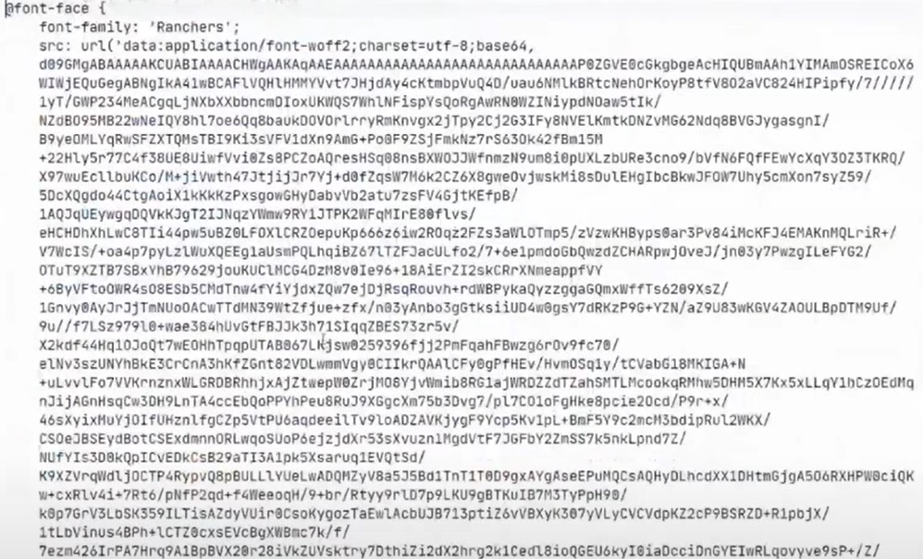
Solving the ancient mystery:
EMBEDDING CUSTOM FONTS
SVG fonts encoded in base64 strings allow embedding custom fonts directly inside applications.
Creative Solution
Convert fonts to an SVG image and simply put the image on your canvas!
How to do it
Download a font
Use an online font converter to translate the font into an SVG stylesheet
Use the stylesheet code as the source of the image in your app
Notes:
It really looked like some childhood gibberish, even after Indy translated it, and it made my head hurt just to look at it. (click)

Slide 21

Method 2 – EMBEDDING SVG FONTS: A LOT OF EFFORT AND BLOAT
It was a trap!
Heavy Payload Issue
Embedding fonts as base64 increased payload size significantly, impacting app performance.
Maintenance Challenges
Managing base64 embedded SVG fonts complicated maintenance and updates of applications.
Notes:
Again, we were met with a TRAP!
While the fonts would be visible on all operating systems and devices, such a complicated process wasn’t scalable, especially because it added significant bloat to our apps!
What to do? What to do? Just when we thought we had found a solution, rusty spikes shot out from the wall, barely missing Indy. And me? Thank you for asking. I suffered a serious injury requiring TWO Band-Aids. This expedition stuff is definitely not for the faint of heart.
There must be a real solution for getting external fonts into PowerApps. If only…

Slide 22
Act III: The ancient wisdom
Discovering early custom font techniques in Power Apps
Notes:
There was only one more lead to pursue. Although still weary from our journey, we boarded the twin-prop and set out again. (click)
(click)

Slide 25

Notes:
What’s this? As we approached our final stop, a golden glow shimmered in the distance. We pulled in closer and discovered a breathtaking cache of precious gems and gleaming gold. I was flabbergasted—Indy, completely unfazed, was staring past the treasure… at the wall behind it.
And there it was. Etched into the stone in ancient, pixel-perfect lettering: “Don’t embed your fonts.” Wait—what? After all that effort?
But then… we heard a whisper from the shadows: “Use the Font Loader.”
Huh? What’s a Font Loader? And who is that whispering like the last surviving web developer from MySpace—still clutching their glittery <marquee> tag and a half-finished Top 8 friends list?
Indy… this guy knows things. Dark things. Things about Comic Sans.
Just then, the ground trembled. A small box rose from the earth at our feet. Indy opened it slowly… and inside was a single scroll. (click)

Slide 26

AN ACIENT SCROLL REVEALED:
The font loader!
What is the answer to this ancient puzzle?
DON’T EMBED YOUR FONTS IN YOUR APP!
Huh? Then how am I supposed to show my fonts?
USE THE FONT LOADER!
What the heck is the font loader?
IT’S A MODULE!
IT’S A CONTROL!
IT’S A DEMO!
IT SLICES! IT DICES! IT MAKES JULIENNE FRIES!
IT’S ALL THAT AND MAYBE MORE!
Notes:
Upon the scroll, we discovered the holy grail. OK… maybe not THE holy grail because Indy already found that, but this was a close second. [CLICK]
So the voice had said NOT to embed or include the fonts we needed in our PCF controls… [CLICK]
…and it said something cryptic about a thing he called the font-loader… [CLICK]
…I still wasn’t getting it, but Indy seemed to understand… [CLICK]

Slide 27
The font loader
IT’S A MODULE
If you’re creating your own PCF controls, it’s a small file that fetches fonts from Google (or another CDN) AT RUNTIME.
IT’S A CONTROL
If you’re an app maker, but NOT creating PCF controls, (because – let’s face it – It’s not for everyone) and simply want to put external fonts in your canvas app, just plug-in the Font Loader Control and use it instead of the built-in TEXT or LABEL controls.
IT’S A DEMO
Well of course I’m going to show it to you. Shield your eyes, though. This could be like the Ark of the Covenant. Only the worthy should gaze upon it.
Notes:
He explained… [CLICK]
As a module, you can use it when authoring PCF controls. It fetches fonts AT RUNTIME. In other words, your fonts aren’t even IN your app until your page loads. No more failed attempts to include fonts! [CLICK]
As a control, Makers can simply use it in place of TEXT or LABEL controls whenever custom text is needed… without bloating their page code. [CLICK]
Finally, as a demo… that’s what we’re here for, but beware… It could be like the Ark of the Covenant. You may need to shield your eyes from its awesome power. [CLICK TWICE]

Slide 28
DEMO TIME!
Notes:
It’s “Demo Time!”. Give me a moment to switch over to PowerApps and we can see the Font Loader in action. [DO NOT CLICK UNTIL AFTER DEMO]

Slide 29
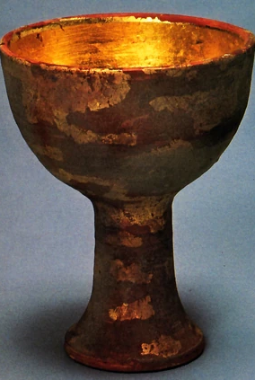
Where can I get it?
https://github.com/korebreach/custom-font-controls
Notes:
So… where can you get the Font Loader? [CLICK]
You’ll find everything you need here, whether you’re looking for a simple control to use in your own projects, want to install the demo, or want to use the module in your own PCF controls. [CLICK]

Slide 30
Credit where credit is due
Eickhel Mendoza
“Learn the many ways to use custom fonts in Power Apps”
Coding
I AM NOT A CODER!
Learning PCF controls through trial and error
Most of my learning has been done through bouncing ideas off Microsoft Copilot, iterating, refining, trying, failing, etc.
Over 2 months trying to put custom fonts into my own project in Power Apps, with the guidance of Copilot, before I found it wasn’t possible to bundle them.
In other words, “Copilot is my copilot!”
Notes:
Even Indy needs help from time to time, so now I want to roll the credits. [CLICK]
First of all, a HUGE shout-out to Eickhel Mendoza who demonstrated this method at a C# conference. Without his inspiration, I would have given up. [CLICK]
Second, contrary to what the demo may imply, I AM NOT A CODER. I must acknowledge and praise Microsoft Copilot for showing me how to do just about everything. [CLICK]
With that… it’s off to the next adventure! [

Slide 31
https://github.com/korebreach/custom-font-controls

